Slide 1

Group project
How to optimize stock portfolio and trading strategy

Slide 2

Table of contents
Basic Price Analysis
Markowitz Portfolio Theory
Trading Strategy

Slide 3
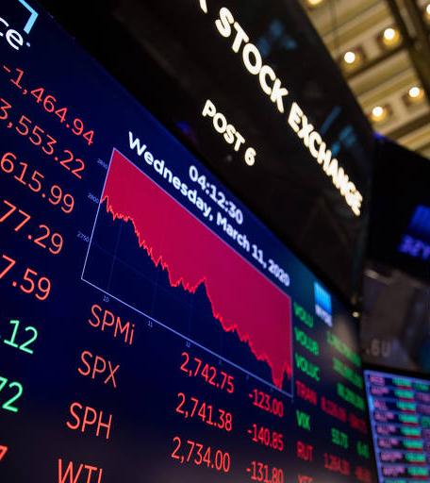
Basic Price Analysis
Peeking at the movement of stock prices in our portfolio, as well as historical returns, and analyze the differences between each stock.

Slide 4





Introduction of portfolio
My group members and I each chose 1-2 of our favorite stocks and put them in our portfolios.
Our portfolio consists of Apple, Netflix, Google, Square and Tesla.
The portfolio includes a wide variety of companies, such as Apple, Google and Netflix, which are established Internet companies with relatively stable revenues; Tesla, an electric car company that has emerged in recent years; and Square, a Fintech company that focuses on payment services.

Slide 5
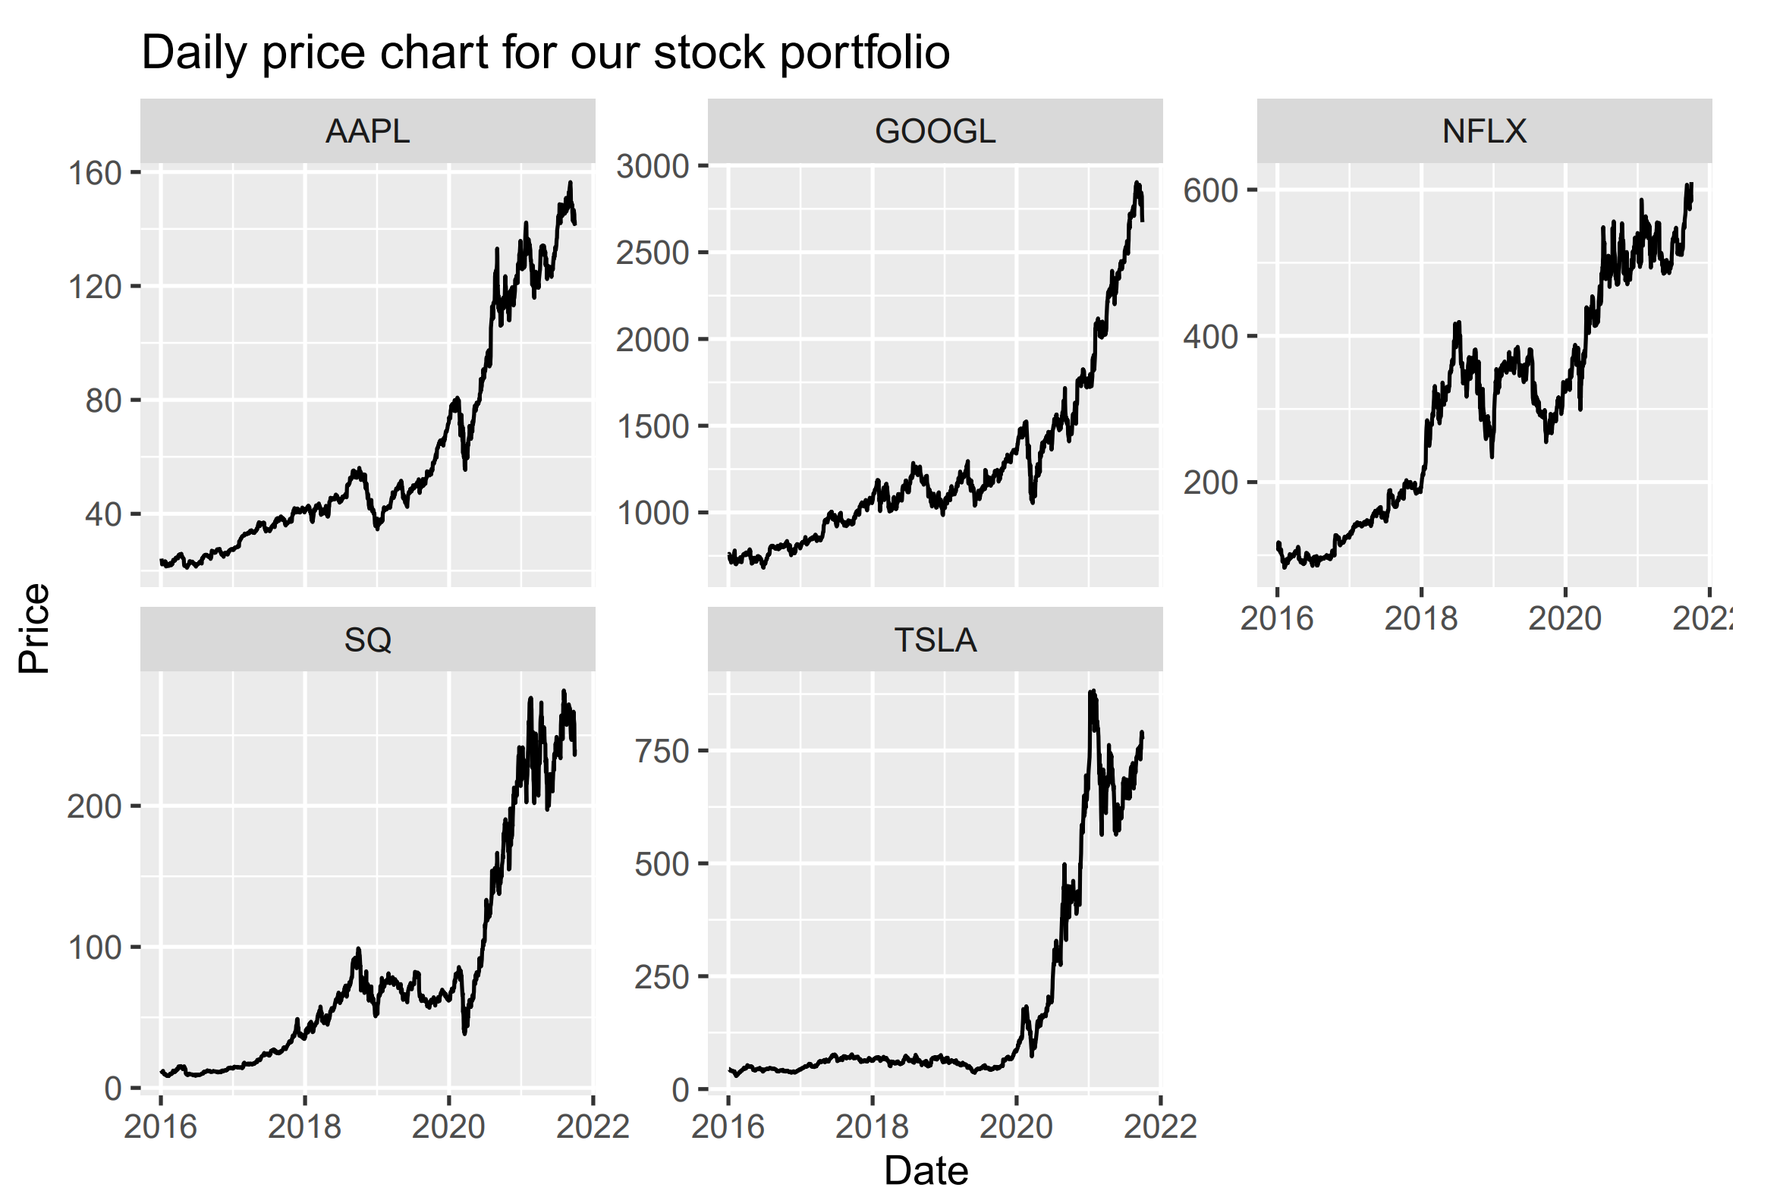
Daily Price Chart
The time frame for all stock prices is from January 4, 2016 to October 1, 2021
All price data was collected from Yahoo Finance
R library “quantmod” or “tidyquant” can help investors to grab data easily
Notes:
You can see that all of the stocks in our portfolio have done very well from 2016-2021, especially after the crash in early 2020, these five stocks have skyrocketed in price. The main reason for this is that the government's quantitative easing policy has kept the prices of assets elevated.

Slide 6
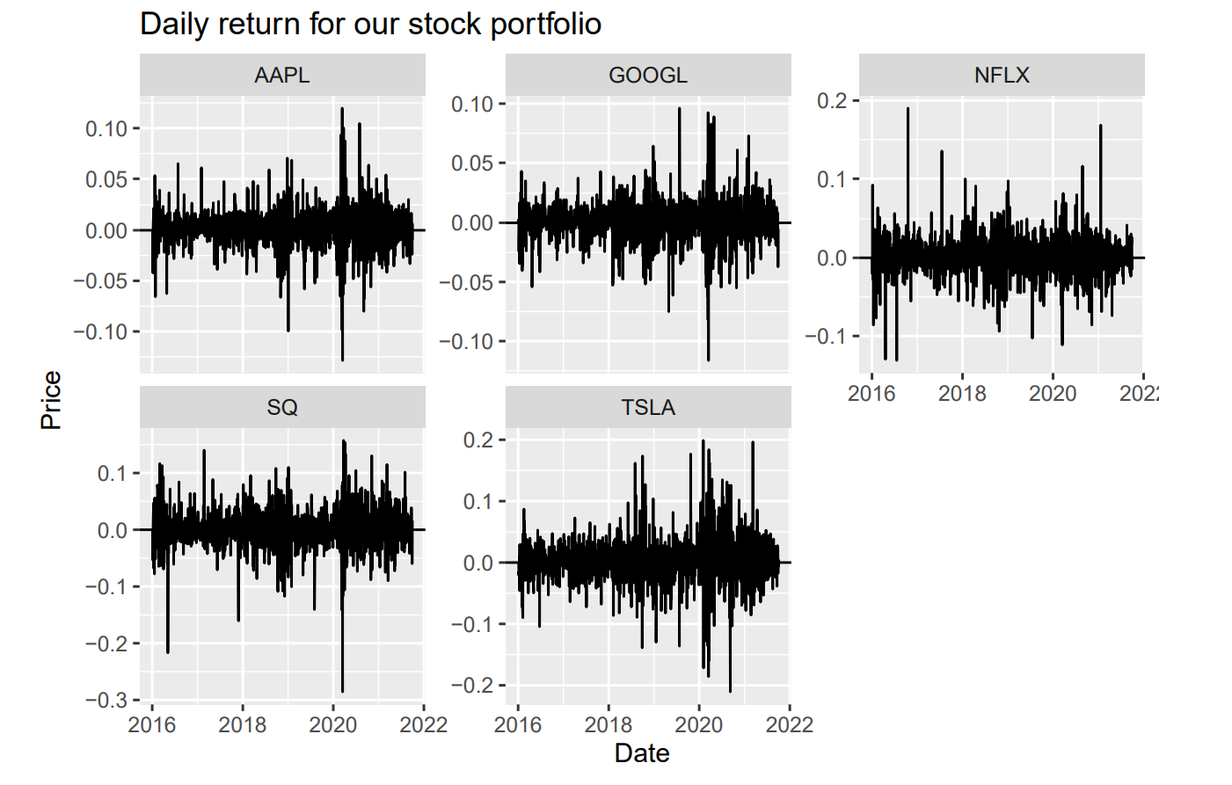
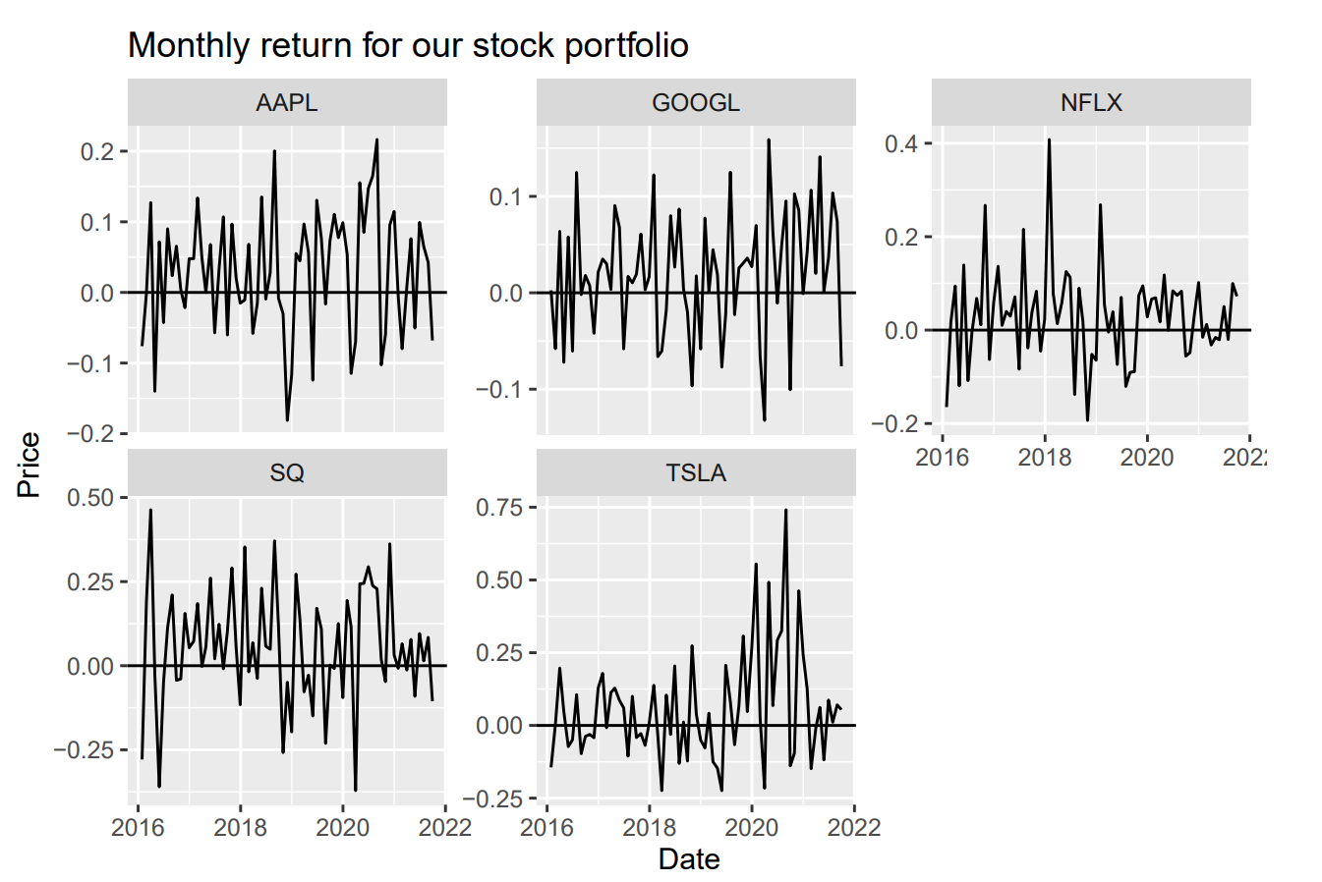
Return Chart
By compiling the historical stock prices, we can get the single day returns and single month returns for these stocks.
In the return chart, we can see more clearly the returns of these stocks. Among them, Tesla and Square's returns fluctuate much more than the other three stocks, especially in the monthly return chart, where this difference looks obvious.
Notes:
This result is not very surprising to me because both Sqaure and Tesla are high growth companies and their scales and business models are improving day by day, so the stock price will be more volatile. We can also see that in August 2020, Tesla stock returned almost 75% in a single month, due to the stock split announced by Tesla in August 2020, which made a lot of money (or retail investors) more willing to buy Tesla stock.

Slide 7
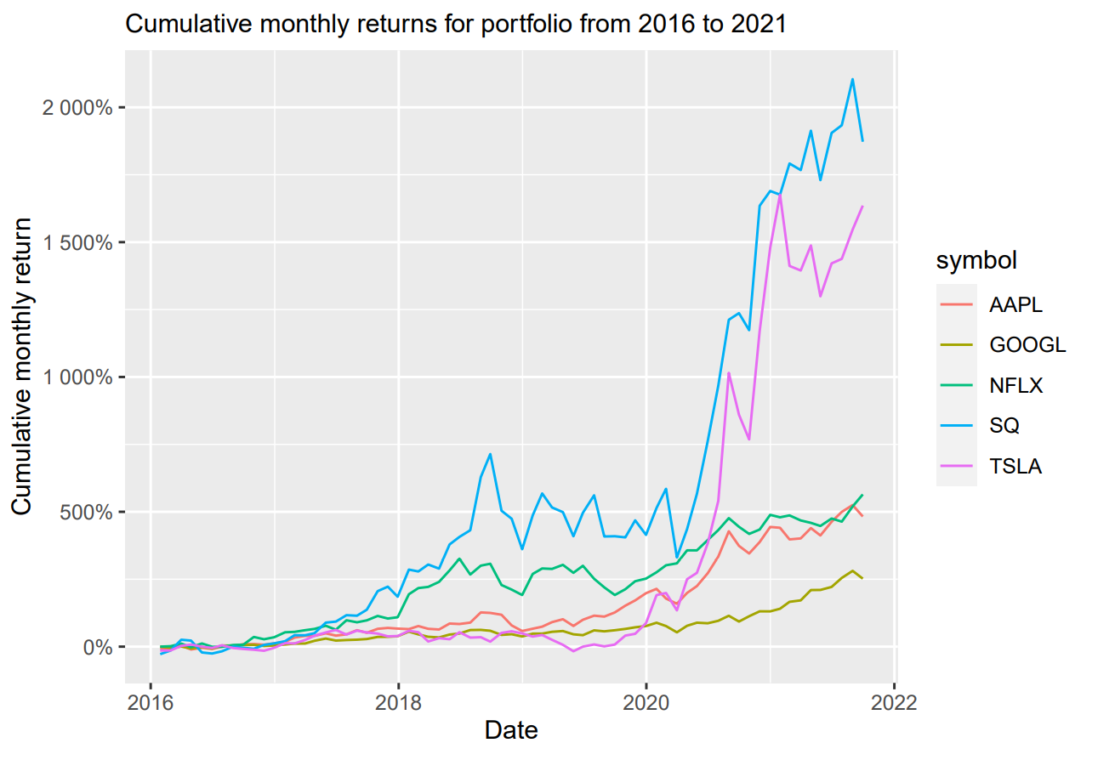
Cumulative return
Sum up the daily return and we can get the cumulative returns for each stock.
Square and Tesla outperformed than other three stocks after 2020.
The charm of value investing
Notes:
This result is in line with expectations, because as companies with high growth rate, Square and Tesla’s market cap will grow faster than other traditional giant companies and the market itself will be willing to pay a premium to buy the emerging companies shares. However, the share prices of Sqaure and Tesla are very volatile, so many investors do not manage to hold them for a long time. Especially for Tesla, holding Tesla’s stock will not help you to gain a lot before 2020. Many investors might bought Tesla’s stock before 2020, but it has a very high probability that those investors gave up continuing to hold Tesla’s stock before the “dawn” because they can’t gain high income for a significant portion of their holding time.

Slide 8
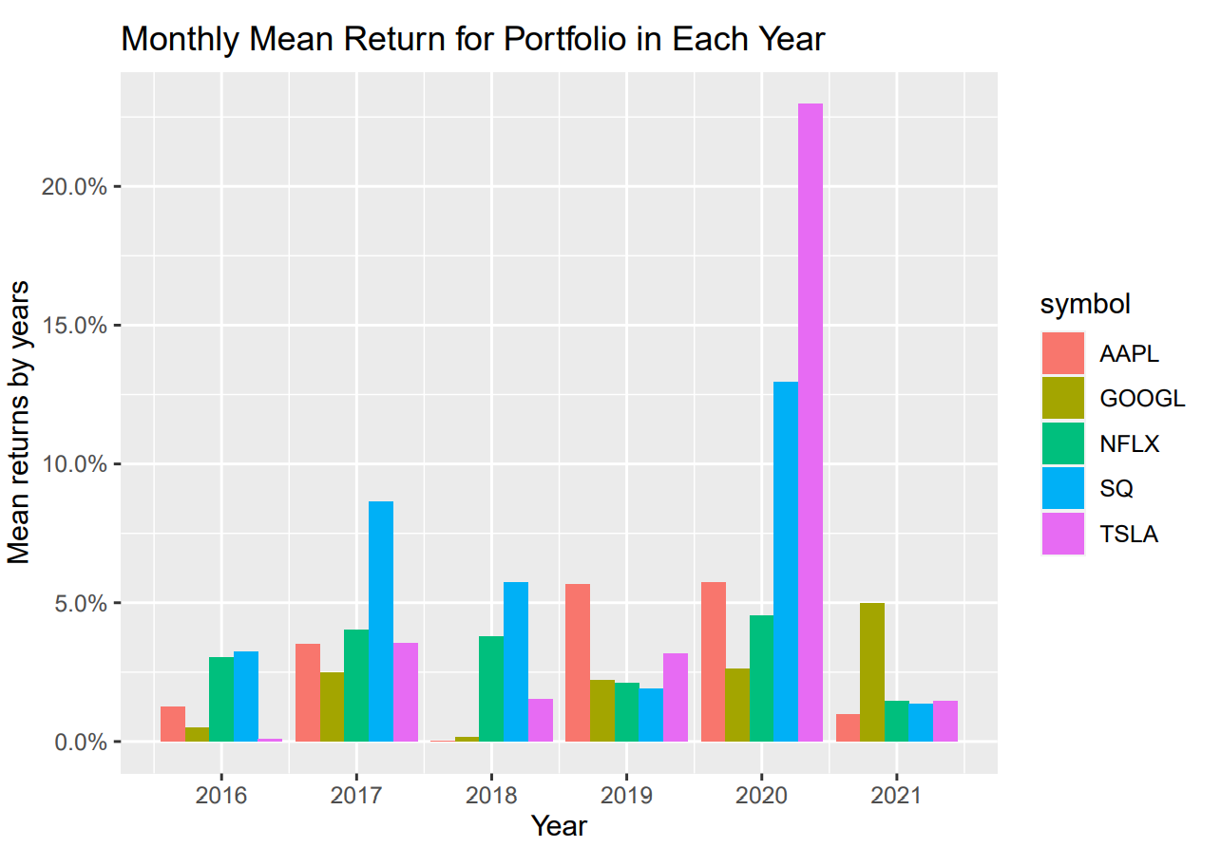
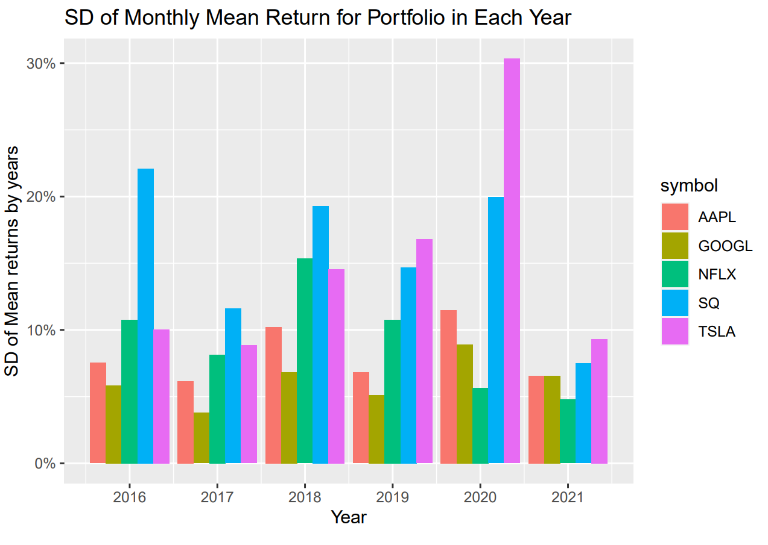
Mean and sd of return
Getting mean and standard deviation of monthly returns for each stock in different years.
Although Tesla and Square have high average monthly returns, these two stocks are more volatile compared to the other three stocks.
Because you can never know in 2019 that Tesla will skyrocket in 2020, a passive holding is likely to give you a high sunk cost.

Slide 9

Markowitz portfolio theory
Portfolio allocation for financial assets is allocating funds rationally to a variety of assets and maximizing the rate of return while controlling the risk within a certain range.
For example, a fixed rate of return that is constant and minimizes risk, or a fixed risk that is constant and maximizes return.

Slide 10
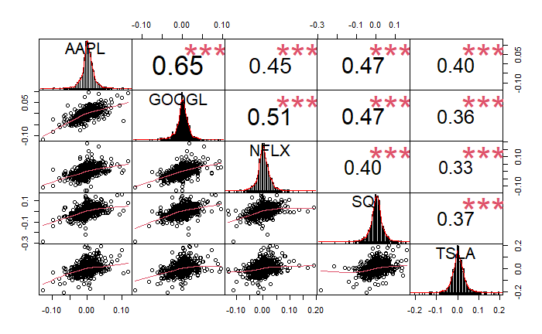
Correlation between each stocks
Getting the correlation of daily returns of each stocks in our portfolio
“Don’t put all your eggs in one basket.”
The threshold of high correlation is about 0.7
Notes:
What we want to do is to first check the historical daily returns of each stock in our portfolio and what their correlations are. There is a very basic principle involved here, the correlation between the returns of each stock in the portfolio should be as low as possible, because if the correlation between the returns of two stocks is high, then there is no need for us to buy two stocks, we can get the same return by buying one of them.

Slide 11
Markowitz portfolio theory
The basic assumptions of Markowitz portfolio theory are:
(1) Single-period investment, as an approximate description of reality in a simplified model, is mainly expressed as an investor investing at the beginning of the period and receiving a return at the end of the period.
(2) Prior knowledge of the probability distribution of investment returns and the conditions under which the returns satisfy a normal distribution.
(3) Investors measure the uncertainty of returns (i.e., risk) and select a portfolio based on the expectation and variance of returns.
(4) Investors follow the principle of predominance to avoid risk and pursue the maximum expected utility, i.e., they choose the higher rate of return for the same risk and the lower risk for the same level of return.

Slide 12
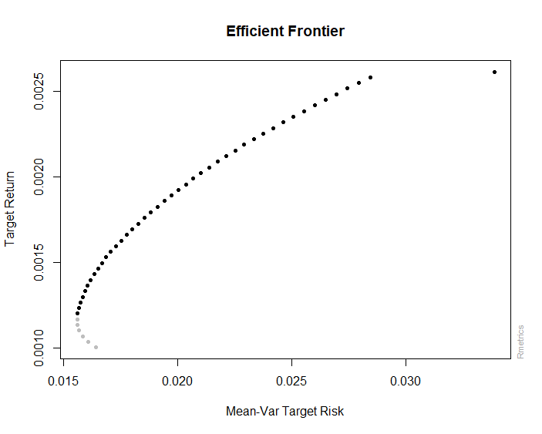
Efficient frontier
The efficient frontier can be basically understood as the optimal return that a portfolio can achieve under a particular risk.
The x-axis of this graph is Mean-Var Target Risk and the y-axis is Target Return
Notes:
Because we use daily return data, so the y-axis also reflects the daily return.

Slide 13
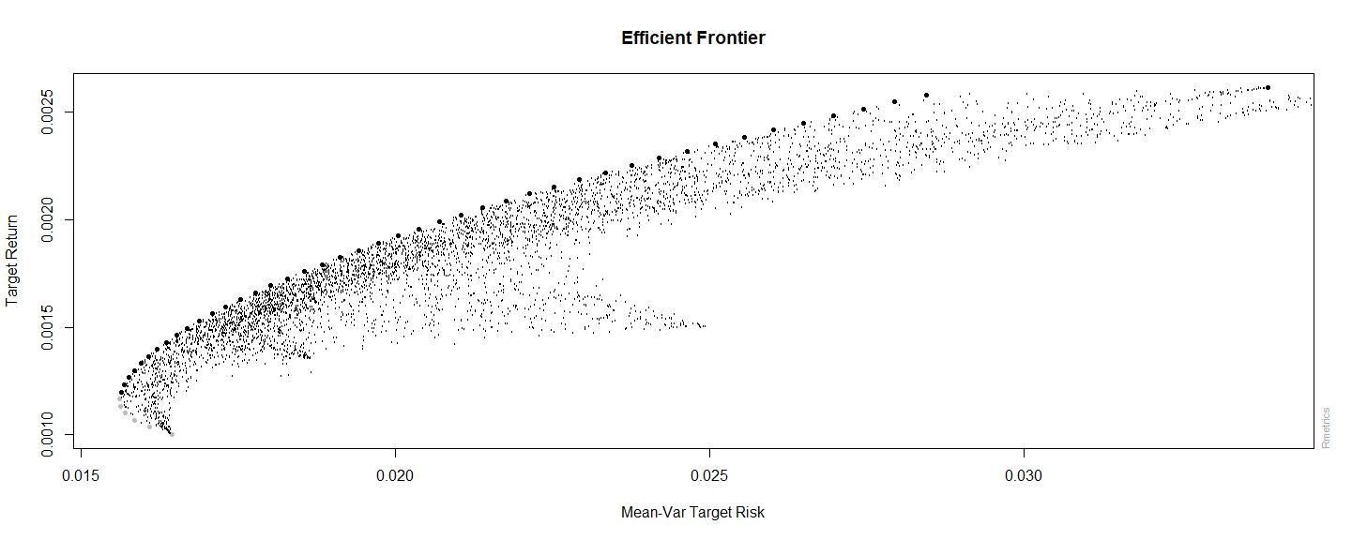
Monte Carlo Portfolio
Monte Carlo simulation allows us to obtain our return/risk ratio under various weightings. It can be found that no matter how you adjust your position weightings, your return/risk ratio cannot exceed the efficient frontier.

Slide 14
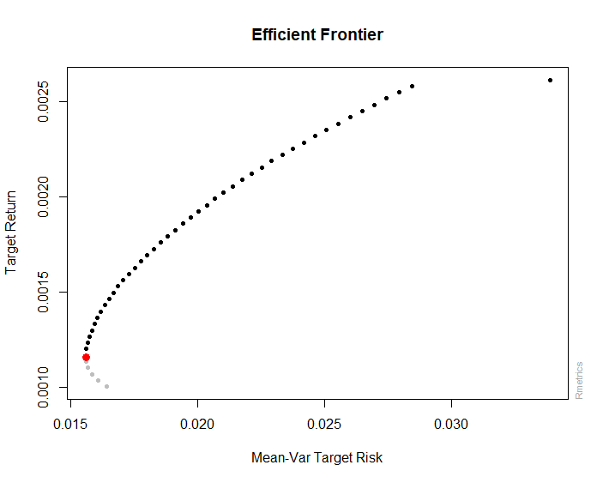
Weighting portfolio
Minimum Mean-Var Target Risk
For conservative investors
How to manage weights in our portfolio?
We need weights plot !!

Slide 15
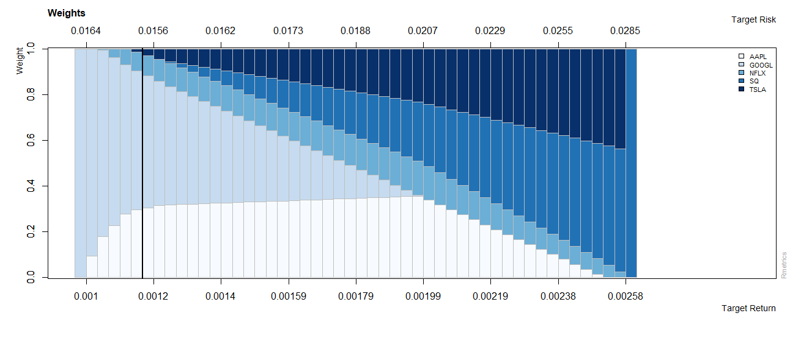
Weights PLOT
By corresponding the points of the efficient frontier to the Weights Plot, you can get the maximum return/risk ratio for what your weight is at the current risk.
At minimum risk portfolio, the portfolio weighting should be 29.30% of Apple, 61.88% of Google, 8.09% of Netflix and 0.73% of Tesla.
Notes:
And this is exactly showed as the thickened line at weights plot.

Slide 16

Best weights of portfolio
The Sharpe ratio was developed by Nobel laureate William F. Sharpe and is used to help investors understand the return of an investment compared to its risk.^{[1]}
The ratio is the average return earned per unit of volatility or total risk over the risk-free rate.
R_{p} = return of portfolio
R_{p} = risk-free rate
σ_{p} = sd of the portfolio’s excess return
[1]:The Nobel Prize. "The Sveriges Riksbank Prize in Economic Sciences in Memory of Alfred Nobel 1990." Accessed Oct. 4, 2021.
Notes:
risk-free rate=yield of 10 years US treasury bond. The risk-free rate of return is the return of an investment with zero risks, meaning it's the return investors could expect for taking no risk.
Divide the result by the standard deviation of the portfolio’s excess return. The standard deviation helps to show how much the portfolio's return deviates from the expected return. The standard deviation also sheds light on the portfolio's volatility.

Slide 17
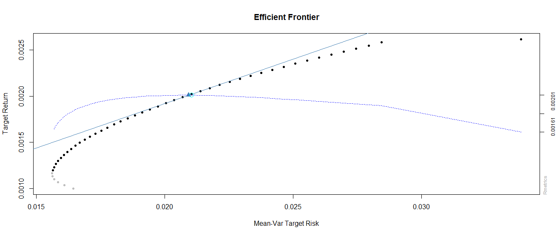
Highest risk/return ratio
The dash curve is the Sharpe ratio curve and the intersection with efficient frontier and Sharpe ratio curve is the point we are looking for.
If we want to get the highest return/risk ratio in our portfolio, the Apple, Netflix, Square, and Tesla stocks should be 34.59%, 14.71%, 26.82%, 23.87% of our portfolio, respectively.

Slide 18

Thank you
someone@example.com

